Slide 1
EMBEDDED SYSTEMS
An embedded system is a system that has software embedded into hardware, which makes a system dedicated for an application (s) or specific part of an application or product or part of a larger system.
Simply stated, all computing systems other than general purpose computer (with monitor, keyboard, etc.) are embedded systems.

Slide 2
Embedded system
Software
Hardware

Slide 3


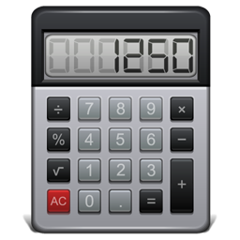

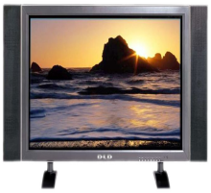
Embedded systems are found in:
Cell phones
Camcorders
Calculators
Digital cameras
Microwave ovens
Washing machines
Printers
Scanners
EMBEDDED
SYSTEMS

Slide 4
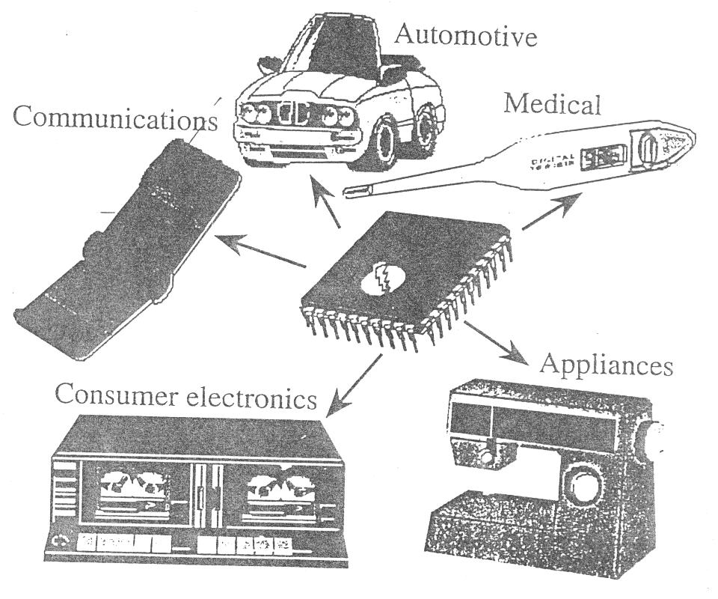

Slide 5
CONSUMER PRODUCTS
TV
stereo
remote control
phone / mobile phone
refrigerator
microwave
washing machine
electric tooth brush
oven / rice or bread cooker
watch
APPLICATION AREAS

Slide 6
APPLICATION AREAS
alarm clock
electronic musical instruments
electronic toys (stuffed animals, handheld toys, pinballs, etc.)
medical home equipment (e.g. blood pressure, thermometer)

Slide 7
APPLICATION AREAS
MEDICAL SYSTEMS
pace maker, patient monitoring systems, injection systems, intensive care units, …
OFFICE EQUIPMENTS
printer, copier, fax, … Tools multimeter, oscilloscope, line tester, GPS, … Banking ATMs, statement printers, …
TRANSPORTATION
(Planes/Trains/[Automobiles] and Boats) radar
traffic lights
Signalling systems, …

Slide 8
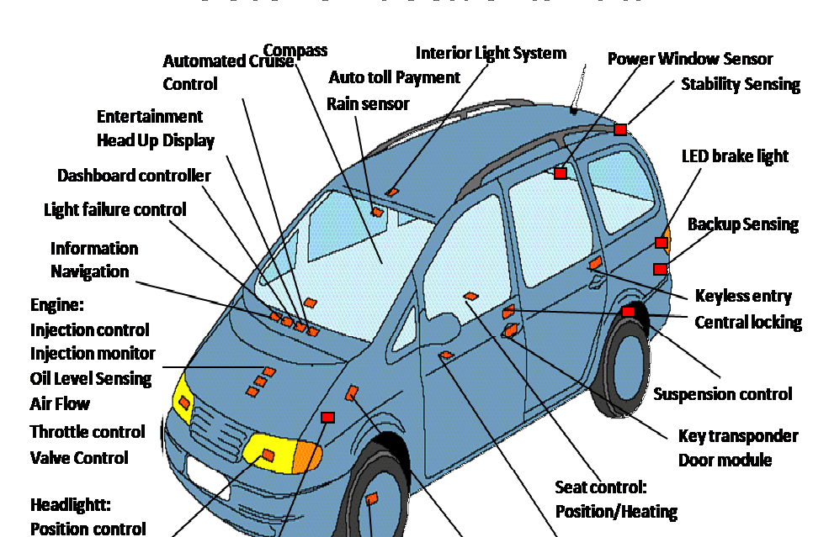

Slide 9
Real -time operation
Must finish operations by deadlines.
Hard real time: missing deadline causes failure.
Soft real time: missing deadline results in degraded performance.
Many systems are multi-rate : must handle operations at widely varying rates.

Slide 10
Embedded System Hardware
Embedded system hardware is used for processing of input to produce output in task specific fashion.
Input Interface
Information
Processing
System
Output
Interface

Slide 11
Processors
Microprocessors and Micro- controllers
Key requirements :
Energy-efficiency
High Code Density

Slide 12
Microprocessors
CPU for Computers.
No RAM ,ROM , I/O on CPU chip itself
Example: Intel’s x86 , Motorola’s 68*0
Data Bus Many chips on motherboard
Address Bus
General Purpose Microprocessors System
CPU
General
Purpose
Microprocessor
RAM
ROM
I/O
Part
Timer
Serial Port

Slide 13
What is Micro-controller ?
Basically, a micro-controller is a device which integrates a number of the components of a microprocessor system on to a single microchip.
A micro-controller combines on the same microchip :
The CPU core
Memory(both ROM and RAM)
Some parallel digital I/O & more

Slide 14
Micro-controller
CPU
Memory
I/O
Bus

Slide 15
Why Micro-controller ?
Low coast small packaging.
Low power consumption .
Programmable , re –programmable.
Lots of I/O capablities
Easy integration with circuits.
For applications in which coast, power and space are critical.
Single-purpose

Slide 16
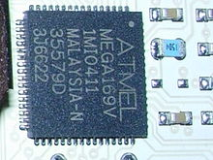
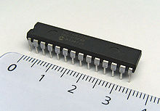
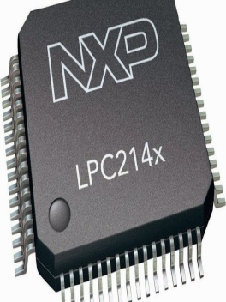
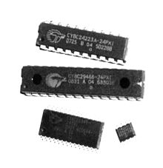
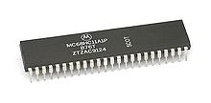
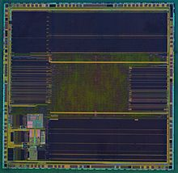
COMMON LIST OF MICROCONTROLLERS
ATMEL
AT89 series
AT91SAM
AVR32
Microchip Technology
8-bit PIC micro
PIC1 & PIC12
PIC16 series
NXP Semiconductors
ARM7
ARM9
ARM Cortex-M0
ARM Cortex-M3
ARM Cortex-M4
Cypress Semiconductor
CY8C2xxxx
CY8C3xxxx
Freescale Semiconductor
8bit:
Freescale S08
68HC05
ST Microelectronics
8-bit :
ST6
ST7

Slide 17
Components of a Micro-controller
A Timer module to allow the micro-controller to perform tasks for certain time periods.
A serial I/O port to allow data to flow between the micro-controller and other devices such as a PC or another micro controller.
An ADC to allow the micro controller to accept analgue input data for processing.

Slide 18
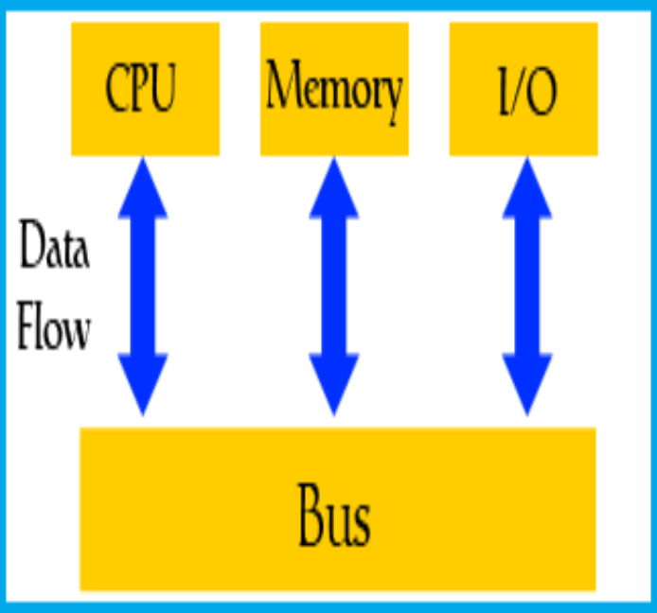
What is in a microcontroller?

Slide 19
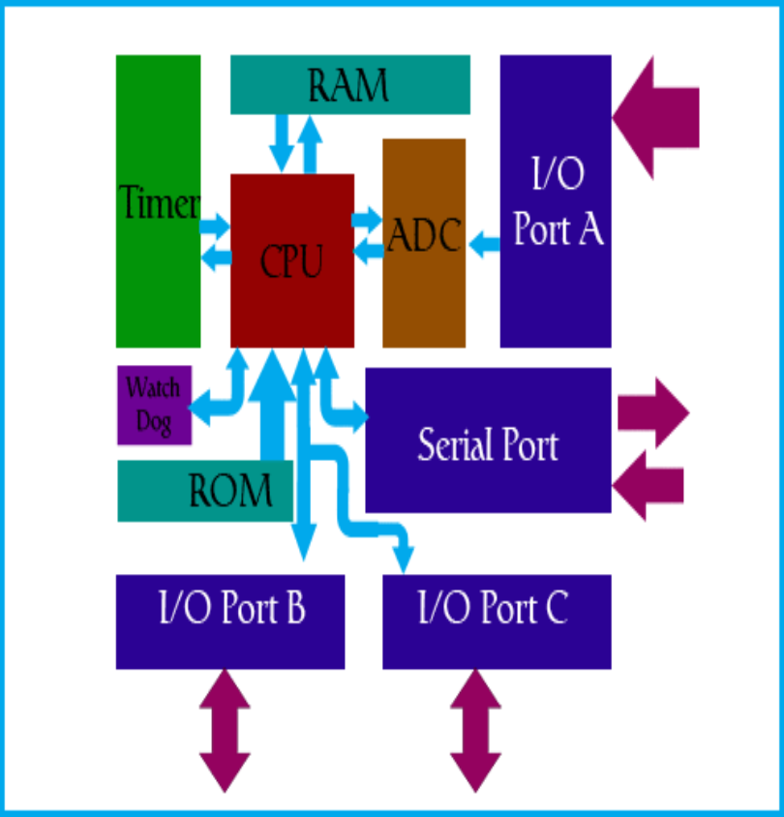
Basic Microcontroller Architecture

Slide 20
Von Neuman Architecture
Only one between CPU and memory.
RAM and program memory share the same bus and the same memory ,and so must have the same bit width.
Bottleneck: Getting instructions interfaces with accessing RAM.
Program and Data memory
Bus
CPU

Slide 21
Harvard Architecture
Separate program bus and data bus: can be different widths
Instruction Pipelining easy.
Data Memory
Program Memory 12/14/16 bits 8 bits
CPU

Slide 22
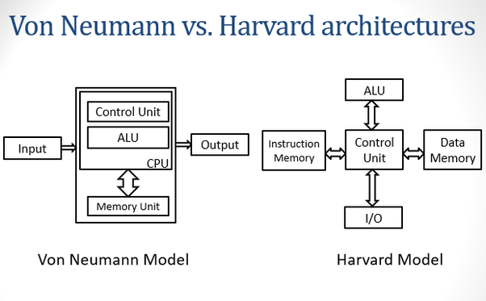

Slide 23
Central Processor Unit (CPU))
As its name suggests, this is a unit which monitors and controls all processes within the microcontroller and the user cannot affect its work. It consists of several smaller subunits.
Read Only Memory (ROM)
Read Only Memory (ROM) is a type of memory used to permanently save the program being executed. The size of the program that can be written depends on the size of this memory.

Slide 24
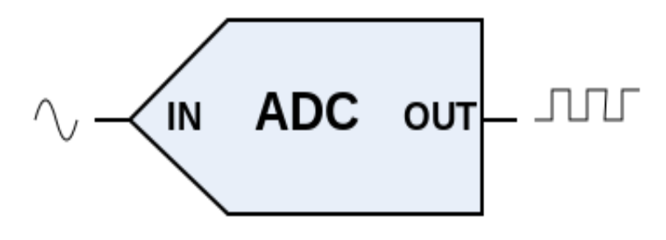
Random Access Memory (RAM)
Random Access Memory (RAM) is a type of memory used for temporary storing data and intermediate results created and used during the operation of the microcontroller.
Analog to Digital Converter (ADC)
This block is responsible for converting an information about some analog value to a binary number and for follow it through to a CPU block so that CPU block can further process it.
Analog to digital converter

Slide 25
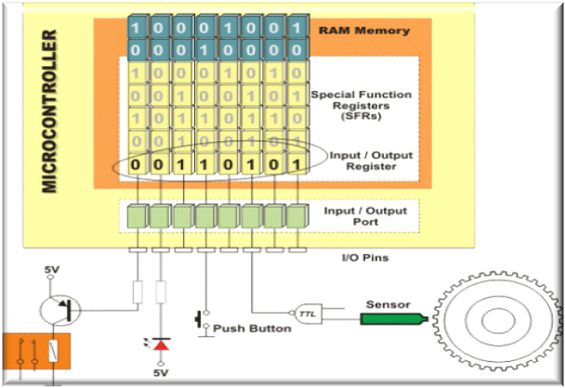
Input/output ports (I/O Ports)
In order to make the microcontroller useful, it is necessary to connect it to peripheral devices. Each microcontroller has one or more registers (called a port) connected to the microcontroller pins.
Interfacing electronic components with general purpose input and output pins

Slide 26
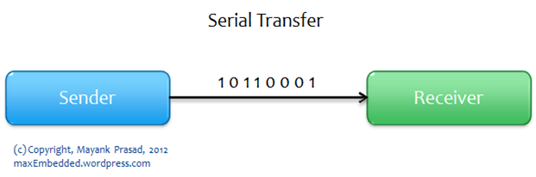
Serial communication
serial communication is the process of sending data one bit at a time, sequentially, over a communication channel or computer bus.
Serial communication is used for all long-haul communication.
Serial transfer

Slide 27
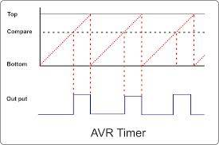
Timers/Counters
AVR TIMER
Most programs use these miniature electronic "stopwatches" in their operation. These are commonly 8- or 16-bit SFRs the contents of which is automatically incremented by each coming pulse. Once the register is completely loaded, an interrupt is generated!

Slide 28

Watchdog timer
A watchdog timer is a piece of hardware that can be used to automatically detect software anomalies and reset the processor if any occur. Generally speaking, a watchdog timer is based on a counter that counts down from some initial value to zero.
Watchdog timers are essential in remote, automated systems such as this Mars Exploration Rover

Slide 29

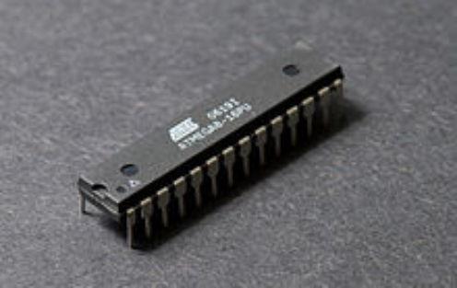
The AVR is a modified Harvard architecture 8-bit RISC single-chip microcontroller, which was developed by Atmel in 1996. The AVR was one of the first microcontroller families to use on-chip flash memory for program storage, as opposed to one-time programmable ROM, EPROM, or EEPROM used by other microcontrollers at the time.

Slide 30
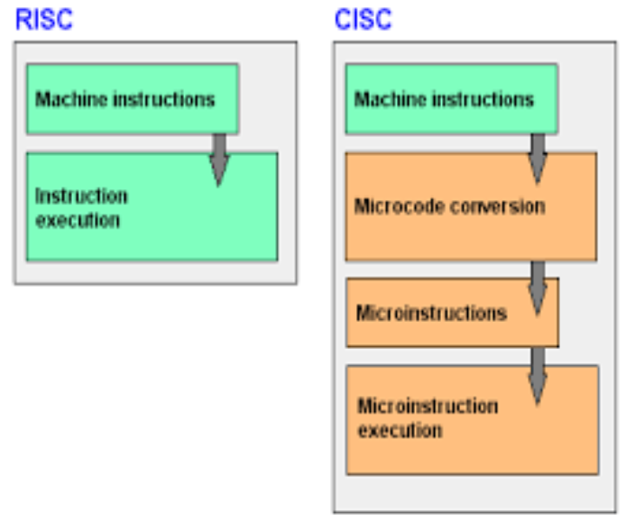
What is RISC?
Reduced instruction set computing, or RISC is a CPU design strategy based on the insight that a simplified instruction set (as opposed to a complex set) provides higher performance when combined with a microprocessor architecture capable of executing those instructions using fewer microprocessor cycles per instruction.

Slide 31

ARDUINO
Arduino is an open-source computer hardware and software company.
It's an open-source physical computing platform based on a simple microcontroller board, and a development environment for writing software for the board.
The open-source IDE can be downloaded for free.

Slide 32
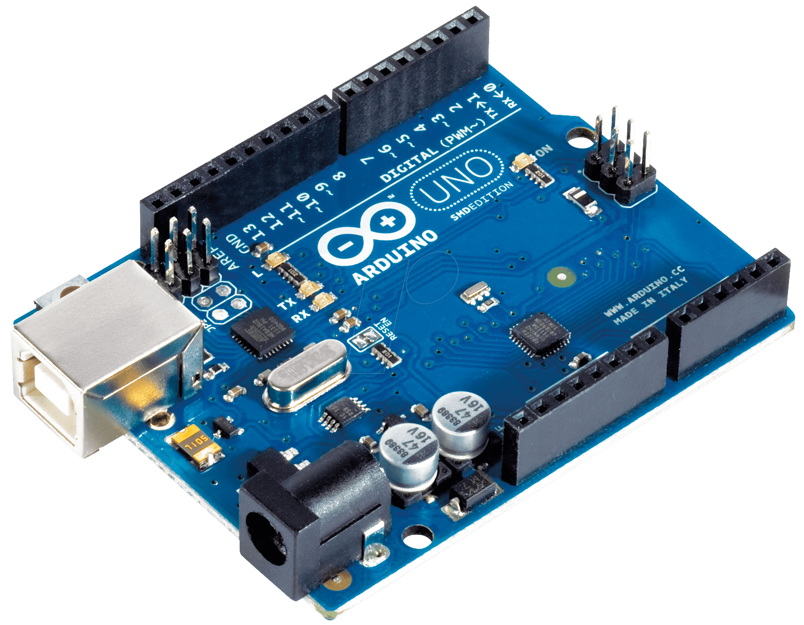
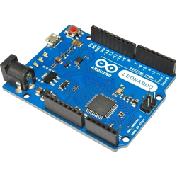
DIFFERENT TYPES OF ARDUINO BOARDS
ARDUINO UNO
ARDUINO LEONARDO

Slide 33
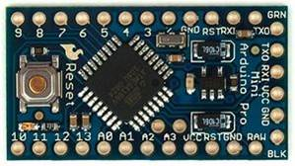
DIFFERENT TYPES OF ARDUINO BOARDS
ARDUINO MINI
ARDUINO NANO

Slide 34
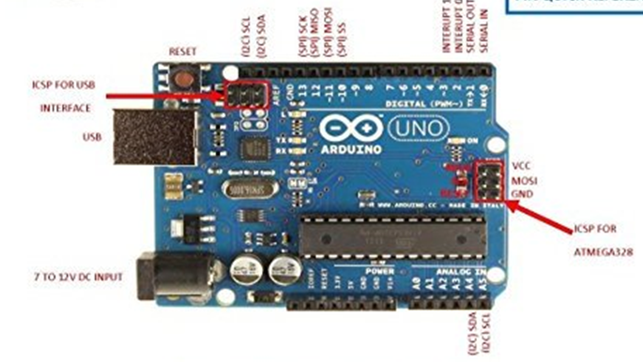
ARDUINO UNO

Slide 35


Slide 36
EMBEDDED SYSTEMS PROGRAMMING
Embedded systems programming is different from developing applications on a desktop computers
Embedded devices have resource constraints(limited ROM, limited RAM, limited stack space, less processing power).
Two salient features of Embedded Programming are code speed and code size.
Embedded systems are programmed using different type of languages:
Machine Code
Low level language, i.e., assembly
High level language like C, C++, Java, Ada, etc.
Application level language like Visual Basic, scripts, Access, etc.

Slide 37

USE OF C IN EMBEDDED SYSTEMS
It is small and reasonably simpler to learn, understand, program and debug.
C Compilers are available for almost all embedded devices in use today, and there is a large pool of experienced C programmers.
Unlike assembly, C has advantage of processor-independence and is not specific to any particular microprocessor/ microcontroller or any system. This makes it convenient for a user to develop programs that can run on most of the systems.

Slide 38

DIFFERENCE BETWEEN C AND EMBEDDED C
C is used for desktop computers, while embedded C is for microcontroller based applications.
Accordingly, C has the luxury to use resources of a desktop PC like memory, OS, etc.
However, embedded C has to use with the limited resources (RAM, ROM, I/Os) on an embedded processor. Thus, program code must fit into the available program memory. If code exceeds the limit, the system is likely to crash.

Slide 39
CONSTANTS | VARIABLES | DATA TYPES | KEYWORDS
CONSTANTS
Alphabets, numbers, and special symbols are combined to form constants, variables and keywords.
A constant is an entity that does not change.
Examples:
Integer constants – 28,102,857 etc.
Real constants – 25.024,100.058,999.99 etc
Character constants – ‘a’ , ’A’ , ‘z’ , ‘=’ , ‘9’

Slide 40
VARIABLES
An variable is an entity that does change.
In programming we have to store the result of calculations and it is stored in the computer memory.
MEMORY CELLS
x 684521
Variable names are the names given to the memory locations.
20

Slide 41
50
x 684521
TYPES OF VARIABLES
The memory cells can contain Integer, Floating point and Character constants.
Type of a variable is nothing but the type of constant that the variable can store.

Slide 42
OPERATORS
An operator is a symbol that tells the compiler to perform specific mathematical or logical manipulations.
C language is rich in built-in operators and provides the following types of operators:
Arithmetic operators
Relational operators
Logical operators
Bitwise operators
Assignment operators
MISC operators

Slide 43
Relational operators
There are following relational operators supported by C++ language
Assume variable A holds 10 and variable B holds 20, then
== Checks if the values of two operands are equal or not, if yes then condition becomes true.
(A == B) is not true.
!= Checks if the values of two operands are equal or not, if values are not equal then condition becomes true.
(A != B) is true.
> Checks if the value of left operand is greater than the value of right operand, if yes then condition becomes true.
(A > B) is not true.
< Checks if the value of left operand is less than the value of right operand, if yes then condition becomes true.
(A < B) is true.
>= Checks if the value of left operand is greater than or equal to the value of right operand, if yes then condition becomes true.
(A >= B) is not true.
<= Checks if the value of left operand is less than or equal to the value of right operand, if yes then condition becomes true.
(A <= B) is true.

Slide 44
Logical Operators
There are following logical operators supported by C++ language
Assume variable A holds 1 and variable B holds 0, then:
&&
Called Logical AND operator. If both the operands are non-zero, then condition becomes true.
(A && B) is false.
||
Called Logical OR Operator. If any of the two operands is non-zero, then condition becomes true.
(A || B) is true.
!
Called Logical NOT Operator. Use to reverses the logical state of its operand. If a condition is true, then Logical NOT operator will make false.
!(A && B) is true.

Slide 45
Assignment Operators
There are following assignment operators supported by C++ language:
= Simple assignment operator, Assigns values from right side operands to left side operand
C = A + B will assign value of A + B into C
+= Add AND assignment operator, It adds right operand to the left operand and assign the result to left operand
C += A is equivalent to C = C + A
-= Subtract AND assignment operator, It subtracts right operand from the left operand and assign the result to left operand
C -= A is equivalent to C = C – A
*= Multiply AND assignment operator, It multiplies right operand with the left operand and assign the result to left operand
C *= A is equivalent to C = C * A
/= Divide AND assignment operator, It divides left operand with the right operand and assign the result to left operand
C /= A is equivalent to C = C / A
%= Modulus AND assignment operator, It takes modulus using two operands and assign the result to left operand .C %= A is equivalent to C = C % A

Slide 46
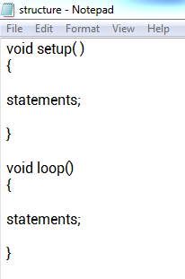
STRUCTURE
The basic structure of the arduino programming language is fairly simple and runs in atleast two parts.
The setup() function is the first function to run in the program , is run only once and is used to set pinMode or initialize serial communication.
The loop() function follows next and includes the code to be executed continuously – reading inputs, triggering outputs etc.

Slide 47
pinMode(pin , mode)
Used in void setup() to configure a specified pin to behave either as an INPUT or an OUTPUT.
pinMode(pin , OUTPUT); // sets ‘pin’ to output.
pinMode(pin , INPUT); // sets ‘pin’ to input.
delay(ms)
Pauses your program for the amount of time as specified in milliseconds, where 1000 equals 1 second.
delay(1000); //waits for 1 second.
digitalWrite(pin , value)
Outputs either logic level HIGH or LOW at a specified pin.
digitalWrite(pin ,HIGH); // sets pin to high.
digitalWrite(pin , LOW); // sets ‘pin’ to low.

Slide 48
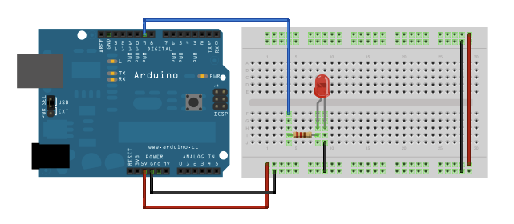
LED ON AND OFF PROGRAM
Blink
This example shows the simplest thing you can do with an Arduino to see physical output: it blinks an LED.
Hardware Required
Arduino Board
LED
Resistor, anything between 220 ohm to 1K ohm
Bread board
Male to male wires – 4
USB cable
Software Required
Arduino software

Slide 49
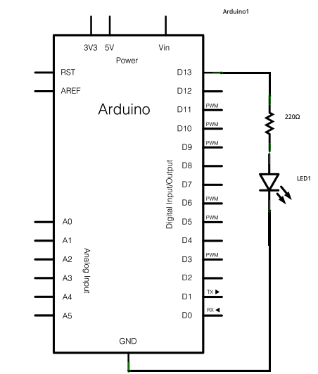
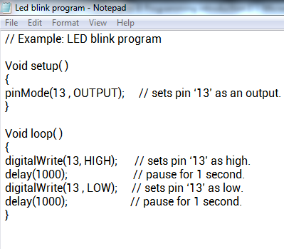
CIRCUIT DIAGRAM
PROGRAM

Slide 50
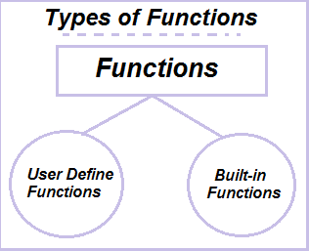
FUNCTIONS
A function is a block of code that has a name and a block of statements that are executed when the function is called.
Functions are declared by first declaring the function type.
This is the type of value to be returned by the function such as ‘int’ for an integer type function.
If no value is to be returned the function type would be void.

Slide 51
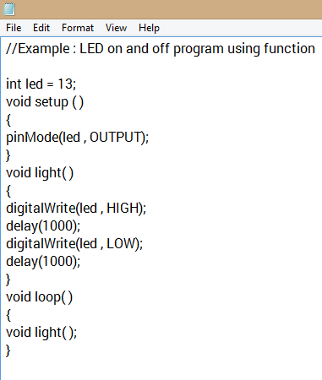
FUNCTIONS
Example program using function

Slide 52
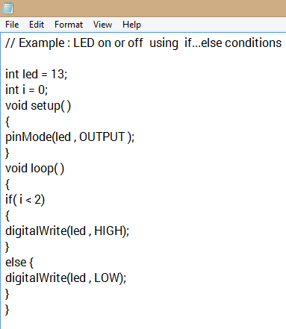
If…else
Example program using if…else
if…else allows for either or decision to be made.

Slide 53
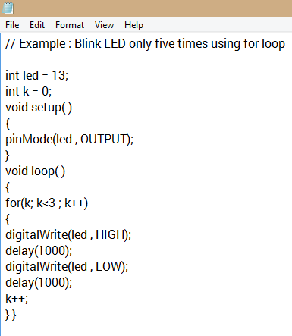
for loop
Example program using for loop
for loop will loop continuously, and infinitely until the expression inside the parenthesis becomes false.

Slide 54
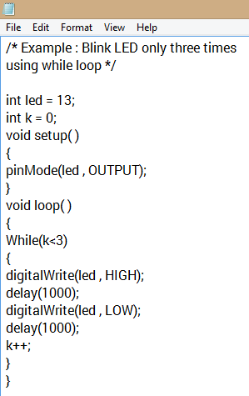
while loop
Example program using while loop
While loops will loop continuously, and infinitely until the expression inside the parenthesis becomes false.
Something must change the tested variable or the while loop will never exit.
while(expression)
{
statements;
}

Slide 55
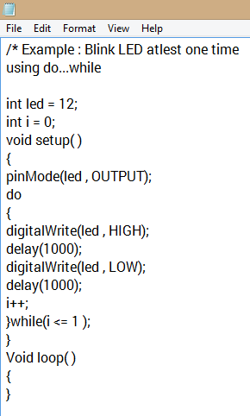
do…while
Example program using do…while loop
This loop will execute the statement atleast one time and then checks the condition.

Slide 56
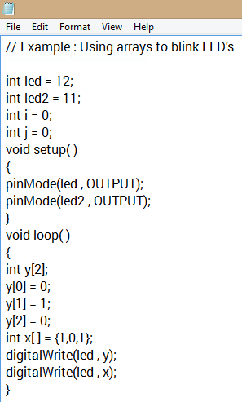
ARRAYS
Example program using arrays
An array is a collection of values that are accessed with an index number.
Any value in the array may be called upon by calling the name of the array and the index number of the value.
An array needs to be declared and optionally assigned values before they can be used.
int myarray[] = { value0 , value1 , value2 …};

Slide 57
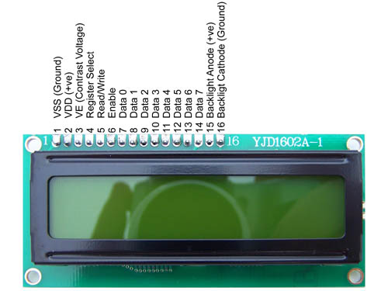
16*2 LCD

Slide 58
PIN NO | FUNCTION | NAME
1 | Ground (0V) | Ground
2 | Supply voltage; 5V (4.7V – 5.3V) | Vcc
3 | Contrast adjustment; through a variable resistor | V_{EE}
4 5 | Selects command register when low; and data register when high. Register Select(RS) - This pin let us choose between sending commands or sending characters to the LCD. Commands: lcd.setCursor(), lcd.clear(). Characters: “Hello World”. Low to write to the register; High to read from the register | Register Select Read / Write

Slide 59
PIN NO | FUNCTION | NAME
6 7 8 9 10 11 12 13 14 15 16 | Sends data to data pins when a high to low pulse is given 8-bit data pins Backlight V_{CC} (5V) Backlight Ground (0V) | Enable DB0 DB1 DB2 DB3 DB4 DB5 DB6 DB7 Led+ Led-

Slide 60
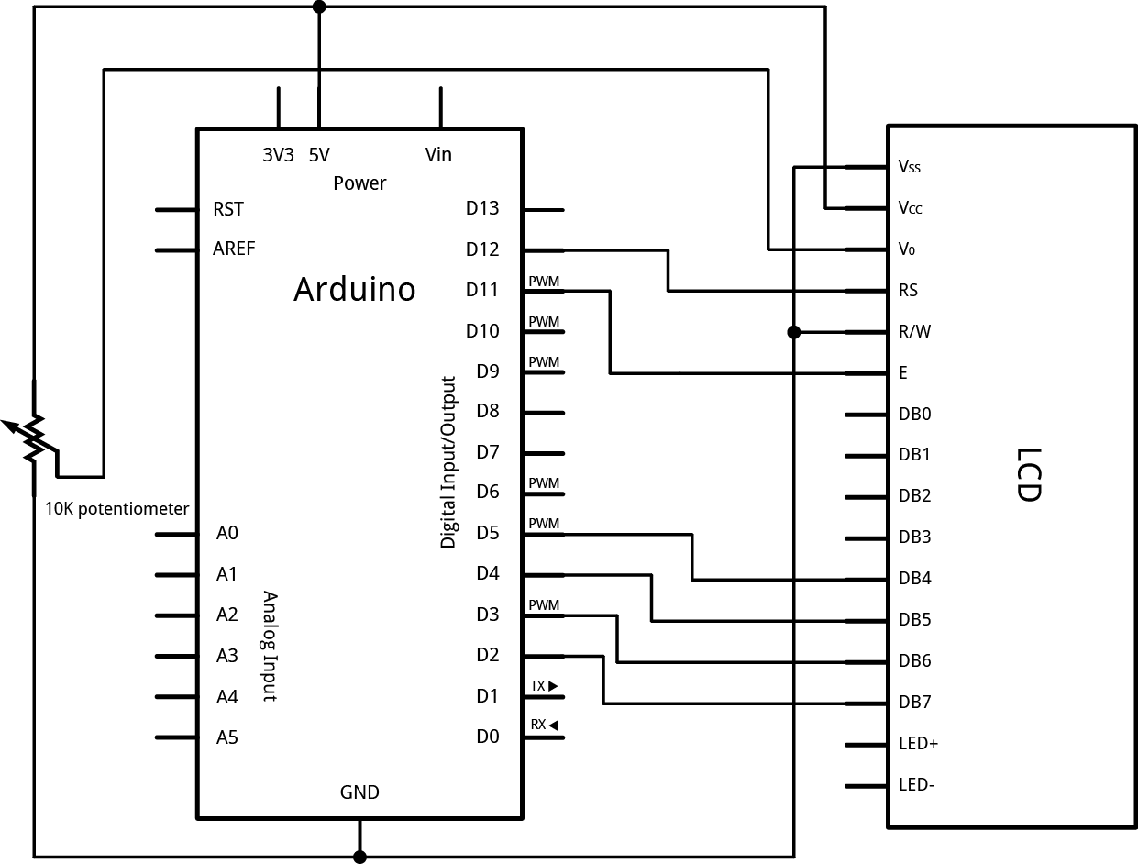
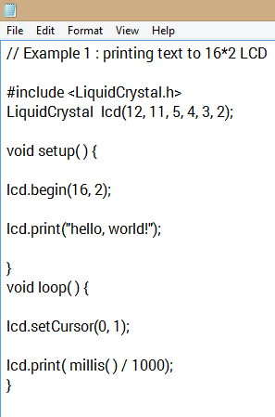
CIRCUIT DIAGRAM
PROGRAM

Slide 61
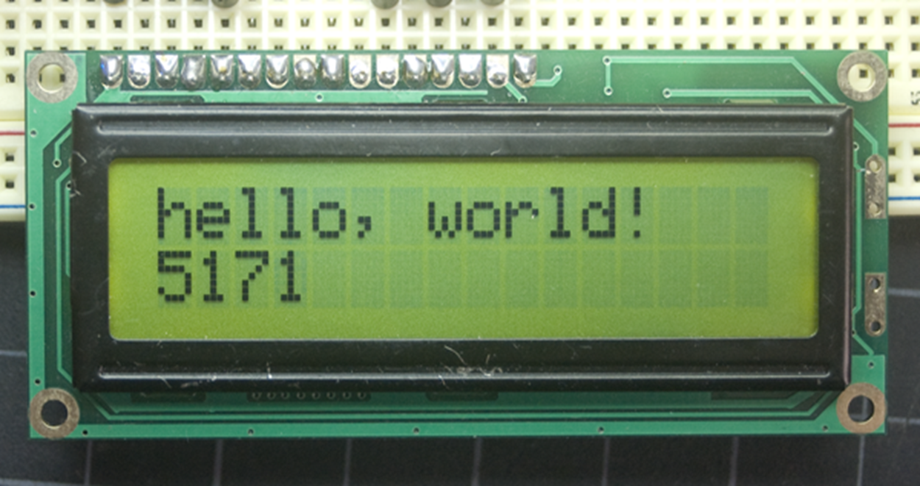
OUTPUT

Slide 62
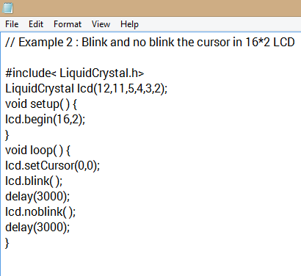
CIRCUIT DIAGRAM
PROGRAM

Slide 63
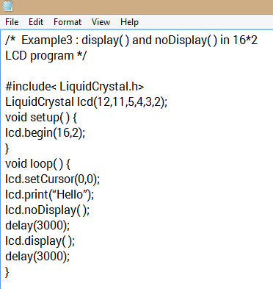
CIRCUIT DIAGRAM
PROGRAM

Slide 64
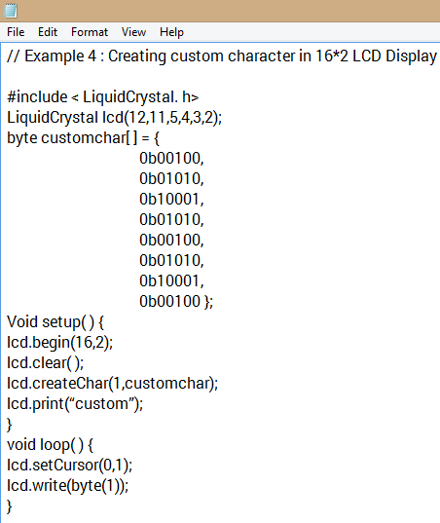
CIRCUIT DIAGRAM
PROGRAM

Slide 65
PWM
FREQUENCY
DUTY CYCLE
PULSE WIDTH MODULATION
Digital I/O pins in microcontroller can only give either 5V or 0V. What if we want 2.5V or variable voltages between 5V and 0V.
A Pulse Width Modulation (PWM) Signal is a method for generating an analog signal using a digital source.
A PWM signal consists of two main components that define its behavior: a duty cycle and a frequency.
PWM signals are used for a wide variety of control applications. Their main use is for controlling DC motors but it can also be used to control valves, pumps, hydraulics, and other mechanical parts.

Slide 66
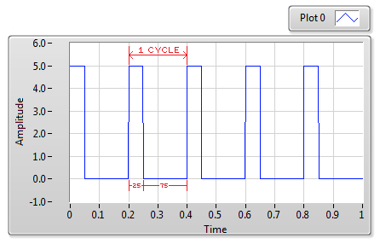
Duty cycle
A duty cycle is the percentage of one period in which a signal is active. A period is the time it takes for a signal to complete an on-and-off cycle.
The average voltage of 50% duty cycle is 2.5v for microcontrollers processing in 5V.
E.g.: 0.5 * 5.0 = 2.5.
The average voltage of 70% duty cycle is 3.75V.
0.75 * 5.0 = 3.75.

Slide 67
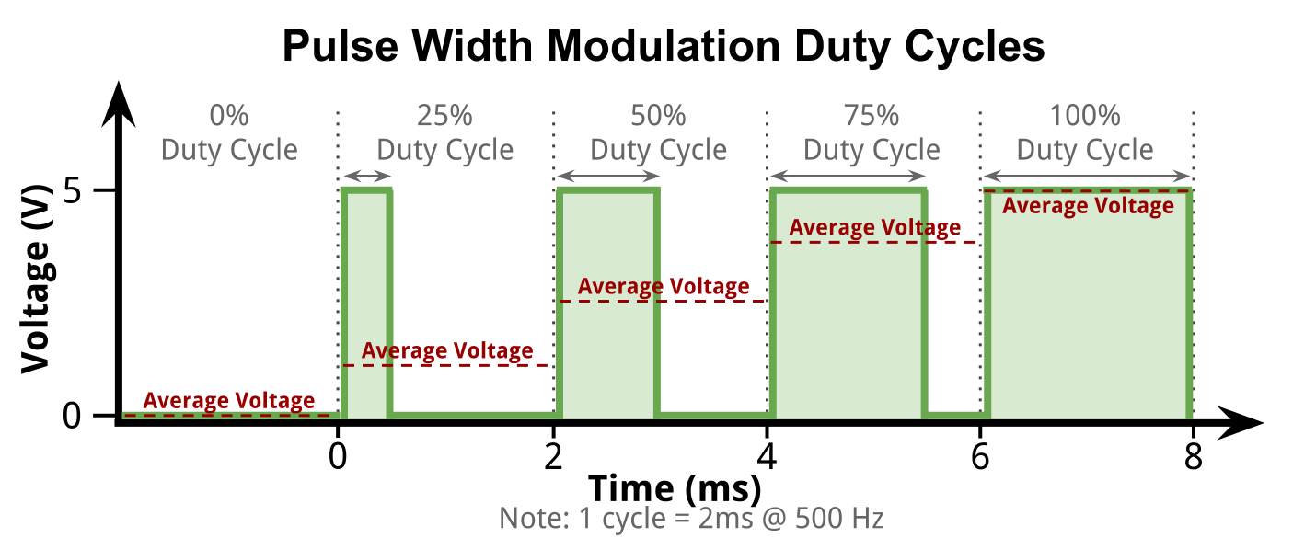

Slide 68
FREQUENCY
The frequency determines how fast the PWM completes a cycle (i.e. 1000 Hz would be 1000 cycles per second), and therefore how fast it switches between high and low states.
HERTZ
The hertz (symbol Hz) is the unit of frequency in the International System of Units (SI) and is defined as one cycle per second.
By cycling a digital signal off and on at a fast enough rate, and with a certain duty cycle, the output will appear to behave like a constant voltage analog signal when providing power to devices.

Slide 69
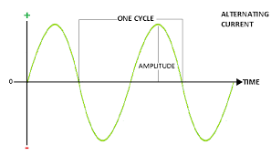
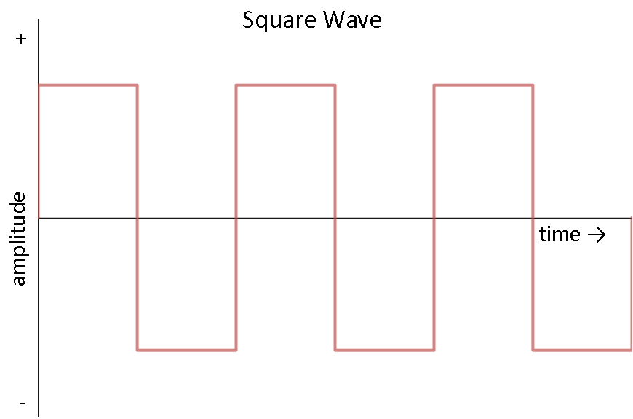
Analog wave
Digital wave

Slide 70
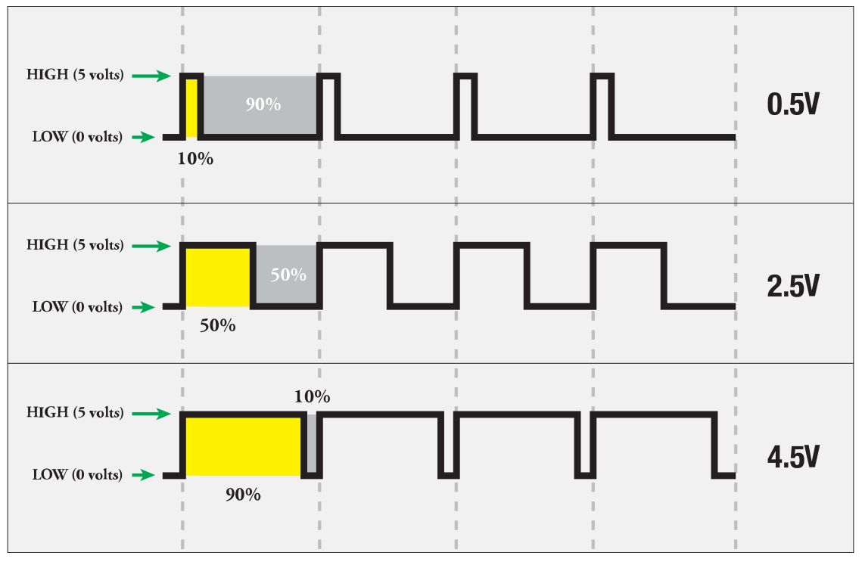
analogWrite(pin , value)
Voltage variations according to duty cycle
Writes a pseudo – analog value using hardware enabled pulse width modulation (PWM) to an output pin marked PWM.
analogWrite (pin , value); // writes ‘value’ to analog ‘pin’
A value of 0 generates a steady 0 volts output at the specified pin.
A value of 255 generates a steady 5 volts output at the specified pin.
For values in between 0 and 255, the pin alternates between 0 and 5 volts – the higher the value, the more often the pin is HIGH(5 volts).

Slide 71
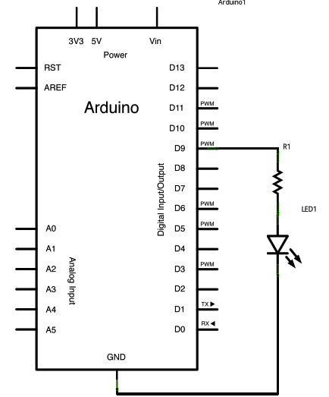
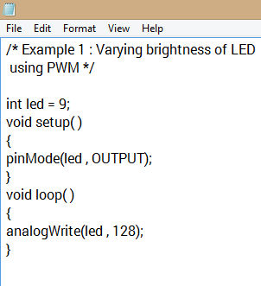
CIRCUIT DIAGRAM
PROGRAM
In the above program, we are giving led an average voltage of 2.5 volts.
Therefore the led will glow at half brightness.

Slide 72
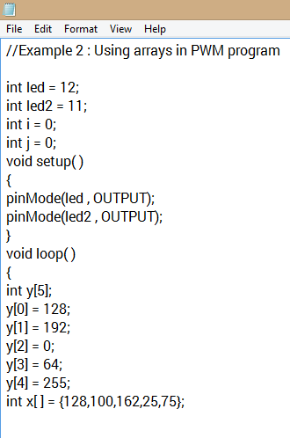
Varying brightness of LED using arrays

Slide 73
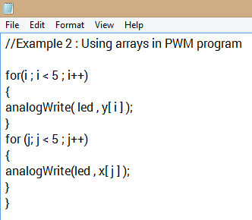
Varying brightness of LED using arrays - continuation

Slide 74
Analog signals
Analog signals – directly measurable quantities in terms of some other quantity.
Examples:
Thermometer – mercury height rises as temperature rises
Car Speedometer – Needle moves farther right as you accelerate
Stereo – Volume increases as you turn the knob.
Analog signals

Slide 75

Digital Signals – have only two states. For digital computers, we refer to binary states, 0 and 1. “1” can be on, “0” can be off.
Examples:
Light switch can be either on or off
Door to a room is either open or closed
Digital signals

Slide 76

An Analog to Digital Converter (ADC) is a very useful feature that converts an analog voltage on a pin to a digital number.
By converting from the analog world to the digital world, we can begin to use electronics to interface to the analog world around us.

Slide 77

Analog to Digital conversion
Microcontrollers are capable of detecting binary signals: is the button pressed or not? These are digital signals. When a microcontroller is powered from five volts, it understands zero volts (0V) as a binary 0 and a five volts (5V) as a binary 1.
What if the signal is 2.72V? Is that a zero or a one? We often need to measure signals that vary; these are called analog signals.
A 5V analog sensor may output 0.01V or 4.99V or anything in between. Luckily, nearly all microcontrollers have a device built into them that allows us to convert these voltages into values that we can use in a program to make a decision

Slide 78

READING ADC VALUE TO VOLTAGE
Relating ADC Value to Voltage
Resolution of the ADC ADC Reading
____________________ = _______________
System voltage Analog voltage measured
Analog to digital conversions are dependant on the system voltage. Because we predominantly use the 10-bit ADC of the Arduino on a 5V system, we can simplify this equation slightly:
1023 ADC Reading
_____ = _________________
5 Analog voltage measured

Slide 79

READING ADC VALUE TO VOLTAGE
If your system is 3.3V, you simply change 5V out with 3.3V in the equation. If your system is 3.3V and your ADC is reporting 512, what is the voltage measured? It is approximately 1.65V.
If the analog voltage is 2.12V what will the ADC report as a value?
1023 x
______ = ______
5V 2.12V
1023 * 2.12V
____________ = x
5V
x = 434.
The ADC should report 434.

Slide 80

analogRead (pin)
Reads the value from a specified pin with a 10 – bit resolution. This function only works on the analog in pins(0 – 15).
The resulting integer values range from 0 to 1023.
value = analogRead(pin);

Slide 81


Program to convert ADC reading to voltage

Slide 82

Serial communication
serial communication is the process of sending data one bit at a time, sequentially, over a communication channel or computer bus.
Parallel communication implies sending a whole byte (or more) of data over multiple parallel wires.
SERIAL COMMUNICATION
SYNCHRONOUS
ASYNCHRONOUS

Slide 83


UART
Single UART packet / Transmission character

Slide 84

Synchronous serial communication
Synchronous serial communication describes a serial communication protocol in which "data is sent in a continuous stream at a constant rate.
Synchronous communication requires that the clocks in the transmitting and receiving devices are synchronized – running at the same rate – so the receiver can sample the signal at the same time intervals used by the transmitter. No start or stop bits are required

Slide 85

Asynchronous serial communication
Asynchronous serial communication is a form of serial communication in which the communicating endpoints' interfaces are not continuously synchronized by a common clock signal. Instead of a common synchronization signal, the data stream contains synchronization information in form of start and stop signals

Slide 86

UART communication between two microcontrollers
The UART, or Universal Asynchronous Receiver / Transmitter, is a feature of your microcontroller useful for communicating serial data (text, numbers, etc.) to your PC. The device changes incoming parallel information (within the microcontroller/PC) to serial data which can be sent on a communication line.
Responsible for breaking apart bytes of data and transmitting them one bit at a time.
Receives serialized bits and converts them back into bytes.

Slide 87

UART communication between MCU and PC/Laptop
Whenever we want to communicate between PC and MCU or between two MCUs , the simplest way to achieve that is using UART.
UART stands for Universal Asynchronous Receiver/Transmitter.
UART communication basically uses 2 pins for Data transfer and these are :
TxD (or Tx) – which is the Transmit Data Pin used to send data.
RxD (or Rx) – which is the Receive Data Pin used to get data.
UART sends & receives data in form of chunks or packets. These chunks or packets are also referred to as ‘transmission characters’.

Slide 88

STRUCTURE OF A DATA PACKET

Slide 89
Signal Timing
Start
D0
D1
D2
D3
D4
D5
D6
D7
Stop
?

Slide 90
Signal Timing
Start
D0
D1
D2
D3
D4
D5
D6
D7
Stop
?
bit period

Slide 91
Serial.print( )
Prints data to the serial port as human-readable ASCII text. This command can take many forms.
Serial.println( )
Prints data to the serial port, followed by an automatic carriage return and line feed.
Serial.available( )
Get the number of bytes (characters) available for reading from the serial port.

Slide 92

BAUD RATE
Baud specifies the inverse of the bit-period
e.g. 9600 Baud = a bit-period of 1/9600 second = 104.2 microseconds
Typical data rates: 75, 110, 300, 1200, 2400, 4800, 9600, 14400, 19200, 28800, 33600, 56000, 115000 and (rarely) 330000 baud.
UBC 104 Embedded Systems
UBC 104 Embedded Systems
92
92

Slide 93


Program
Output
Printing text to serial monitor
UBC 104 Embedded Systems
UBC 104 Embedded Systems
UBC 104 Embedded Systems
93
93
93

Slide 94

Blink LED using serial monitor
UBC 104 Embedded Systems
UBC 104 Embedded Systems
UBC 104 Embedded Systems
94
94
94

Slide 95

Blink LED through serial monitor using string
UBC 104 Embedded Systems
UBC 104 Embedded Systems
UBC 104 Embedded Systems
95
95
95

Slide 96

I²C (Inter-Integrated Circuit)
pronounced I-squared-C, is a multi-master, multi-slave, single-ended, serial computer bus invented by Philips Semiconductor (now NXP Semiconductors). It is typically used for attaching lower-speed peripheral ICs to processors and microcontrollers.

Slide 97

Two signal wires : Serial data (SDA) and Serial clock(SCL)
Synchronous communication
Bi-directional data transfer(not simultaneous)
Multi-master support
Byte-oriented transfers(8 bits)
Wide range of bus speeds:
Standard mode : 100 Kbps
Fast mode : 400 Kbps
Fast mode plus : 1 Mbps
High-speed mode : 3.4 Mbps
Ultra fast mode : 5 Mbps(unidirectional)

Slide 98

To write a single byte:
1.All: Allow SDA,SCL start high.
2.Master: SDA low to signal start high
3.Master: Send out SCL, and 7 bit address followed by 0(W) on SDA.
4.Slave: Pull SDA low to signify Acknowledge
5.Master: Send out 8 data bits on SDA
6.Slave: ACK
7.All: Allow SDA to go high when SCL is high (stop).
For “Read”
3.Master: Address following by 1(R) on SDA.
5.Slave: Send out 8 bits on SDA
6.Master: ACK

Slide 99
Wire.begin()
Wire.begin(address)
Description :
Initiate the Wire library and join the I2C bus as a master or slave. This should normally be called only once.
Wire.beginTransmission(address)
Description:
Begin a transmission to the I2C slave device with the given address.
Wire.requestFrom()
Description:
Used by the master to request bytes from a slave device.
Wire.endTransmission()
Description:
Ends a transmission to a slave device that was begun by beginTransmission().

Slide 100
Wire.write()
Description:
Writes data from a slave device in response to a request from a master, or queues bytes for transmission from a master to slave device.
Wire.available()
Description:
Returns the number of bytes available for retrieval with read().
Wire.onReceive(handler)
Description:
Registers a function to be called when a slave device receives a transmission from a master.
Wire.onRequest(handler)
Description:
Register a function to be called when a master requests data from this slave device.

Slide 101


Controlling LED in arduino uno using arduino mega

Slide 102


Slave to master – Receiving characters from slave to master

